Slide 1
Team6
BNN – Binarized CNN
NTU GIEE
Media IC & System Lab
R09943010 陳昱愷
R09943014 楊凱翔
R09943024 孫名志
2021/01/22

Slide 2
Outline
Basic introduction to BNN and FINN
Optimization and resource utilization trade-off
Overall system flow
Implementation on FPGA (Pynq-Z2 board)
Experiments

Slide 3
Outline
Basic introduction to BNN and FINN
Optimization and resource utilization trade-off
Overall system flow
Implementation on FPGA (Pynq-Z2 board)
Experiments

Slide 4
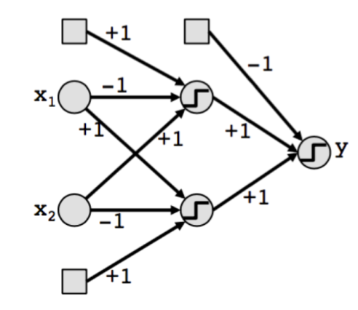
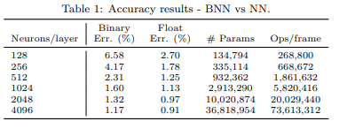
BNN – Binary NN
Advantage of BNN
save storage and reduce memory bandwidth requirements
replace floating-point operations w/ binary operations, like multiplier/XNOR, pooling/OR
could be efficiently performed on the LUT-based FPGA
Performance of BNN
According to [1], on MNIST dataset, it reach 4.17 % error rate with #256 neurons and decrease by 2.5% with #1024 neurons.
Much less parameters are used than traditional NN.
[1] M. Courbariaux and Y. Bengio. Binarynet: Training deep neural networks with weights and activations constrained to +1 or -1. CoRR, abs/1602.02830, 2016

Slide 5
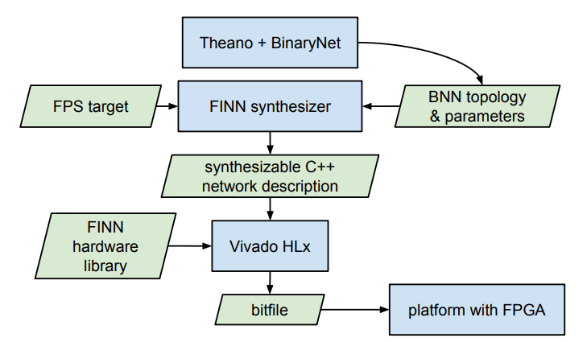
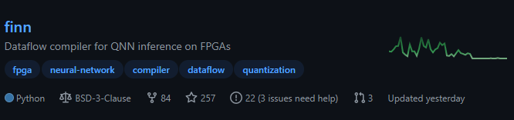
FINN
Introduction to FINN[2]
FINN is an experimental framework from Xilinx Research Labs to explore deep neural network inference on FPGAs.
FINN is a framework for building fast and flexible FPGA accelerators.
github resource:
https://github.com/Xilinx/finn
[2] https://xilinx.github.io/finn/

Slide 6
Outline
Basic introduction to BNN and FINN
Optimization and resource utilization trade-off
Overall system flow
Implementation on FPGA (Pynq-Z2 board)
Experiments

Slide 7
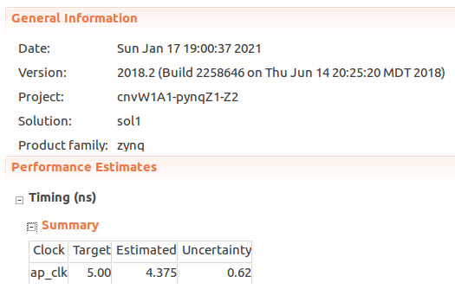
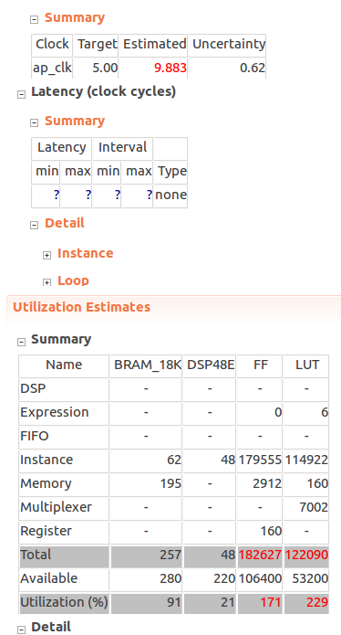
Implement the source code
Negative slack issue
Resource utilization issue

Slide 8
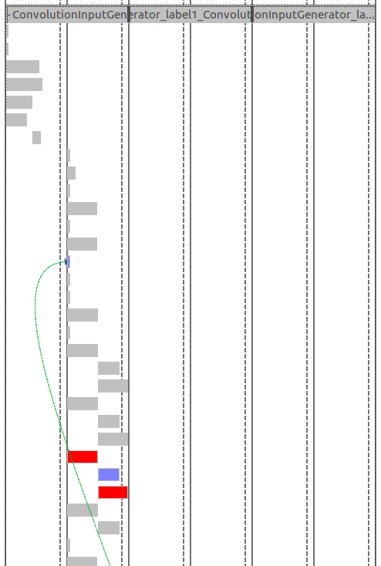
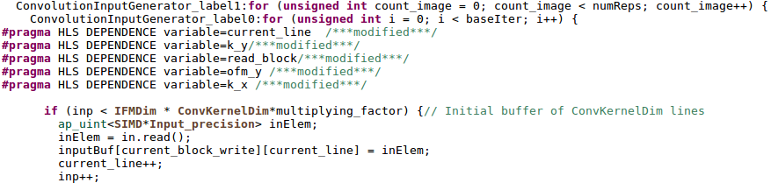
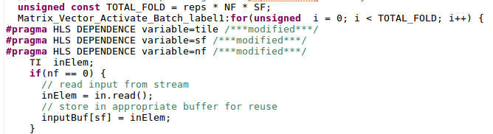
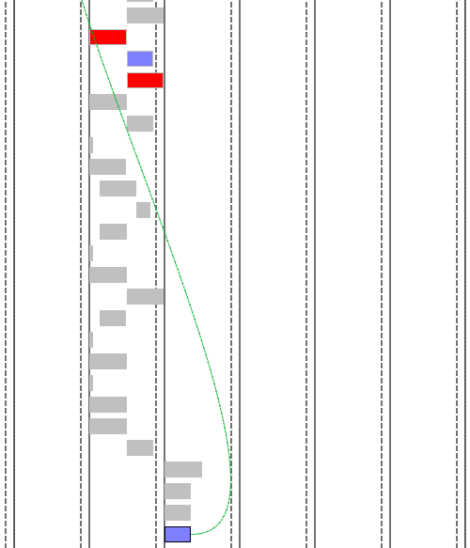
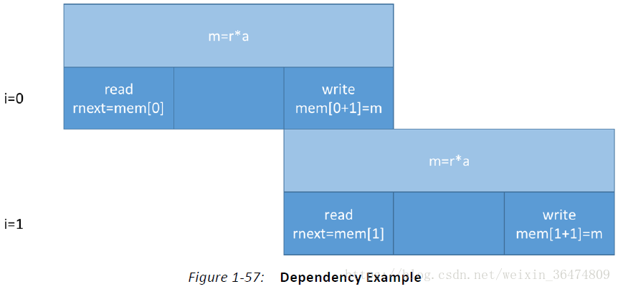
Solve negative slack issue (1/2)
The generated dependence problem after pipelining

Slide 9
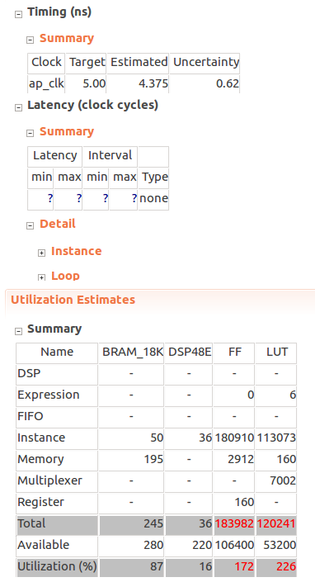
Solve negative slack issue (2/2)
Negative slack issue solved
Resource utilization issue remained

Slide 10
Solve Resource utilization issue (1/3)
Doing convolution with less DSP core!!!!?

Slide 11
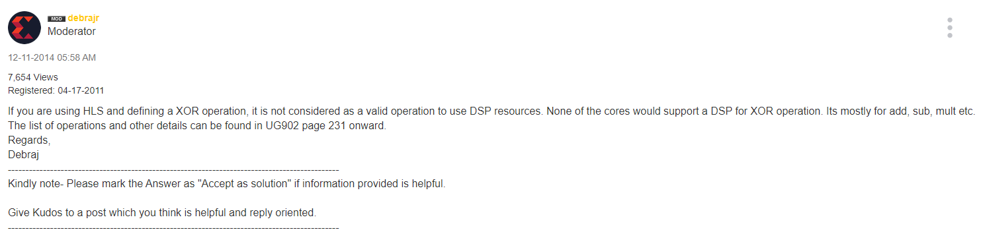
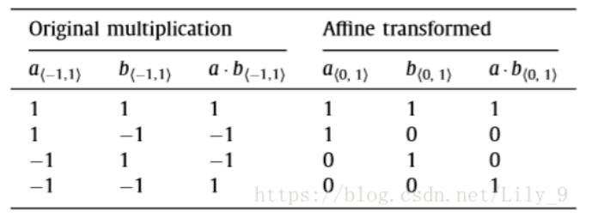
Solve Resource utilization issue (1/3)
Doing convolution with less DSP core!!!!?

Slide 12
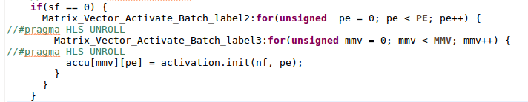
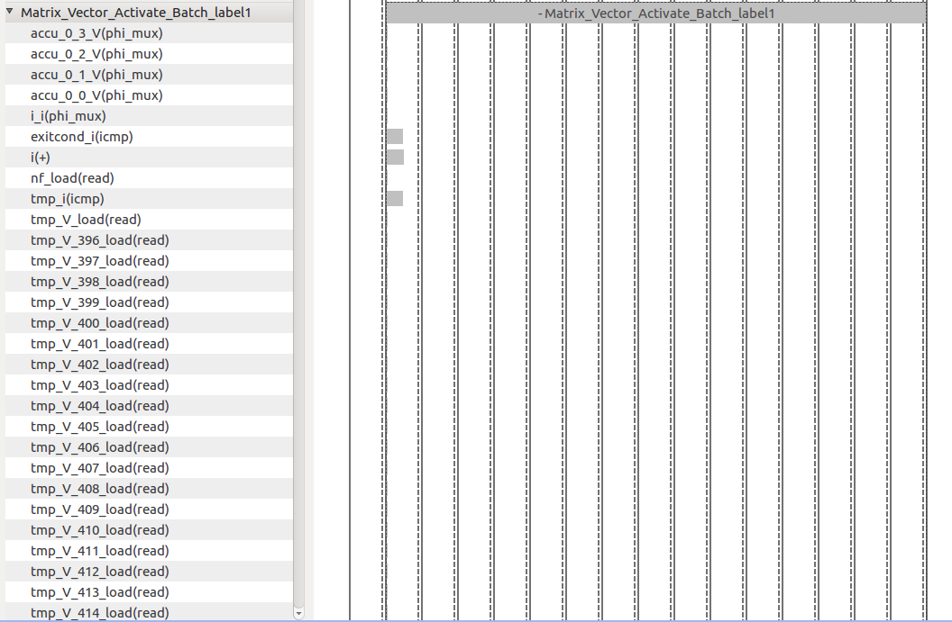
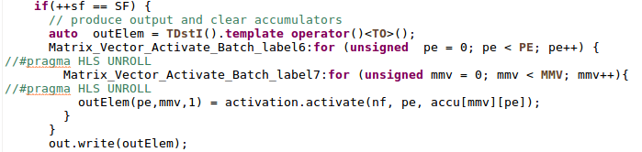
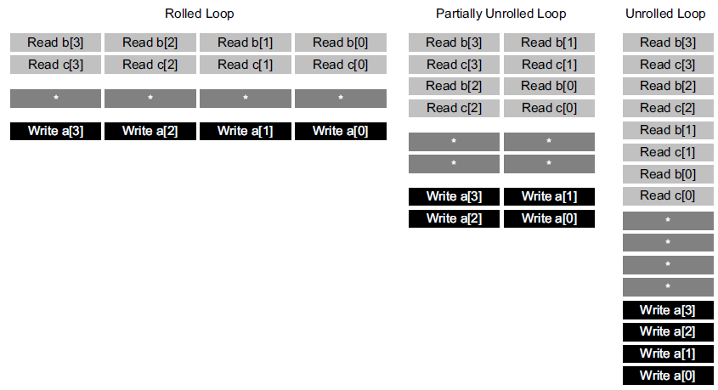
Solve Resource utilization issue (2/3)
Cancel some unroll and pipeline

Slide 13
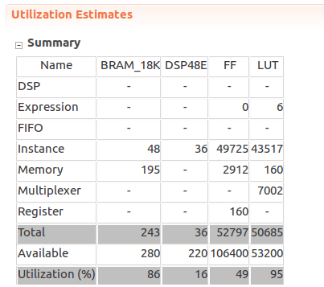
Solve Resource utilization issue (3/3)
Negative slack issue solved
Resource utilization issue solved

Slide 14
Outline
Basic introduction to BNN and FINN
Optimization and resource utilization trade-off
Overall system flow
Implementation on FPGA (Pynq-Z2 board)
Experiments

Slide 15
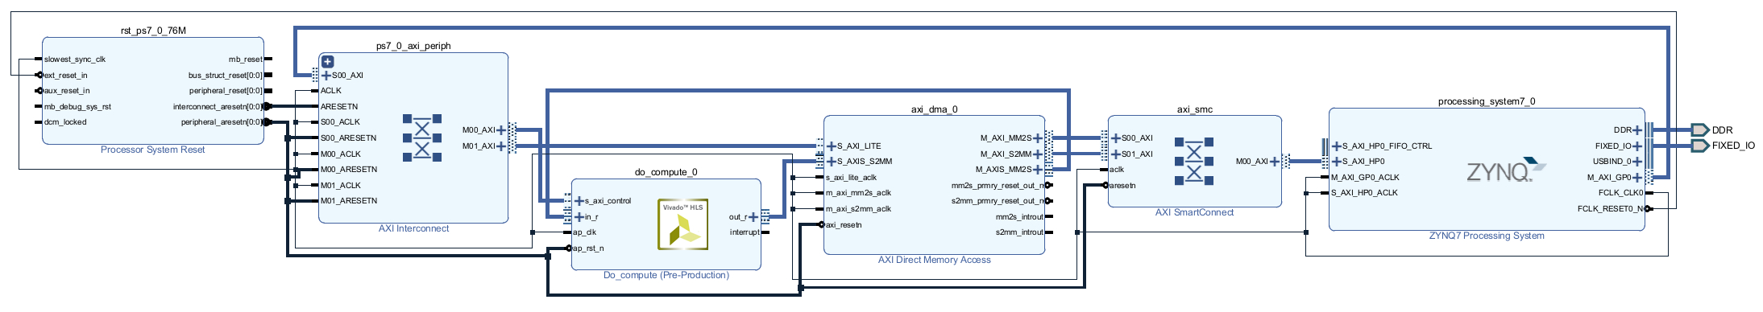
Block diagram design and system flow
Control signal
AXI lite
Host
Image
kernel
AXI master
Predict score
AXI master

Slide 16
Outline
Basic introduction to BNN and FINN
Optimization and resource utilization trade-off
Overall system flow
Implementation on FPGA (Pynq-Z2 board)
Experiments

Slide 17

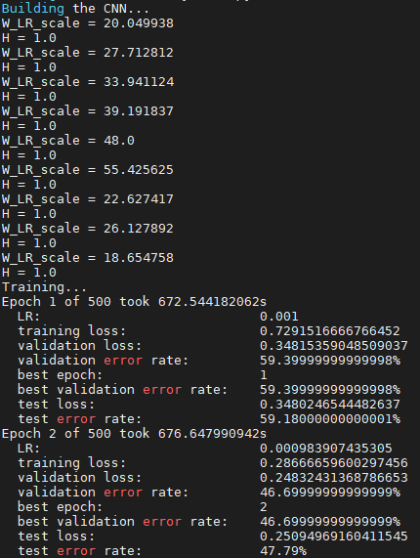
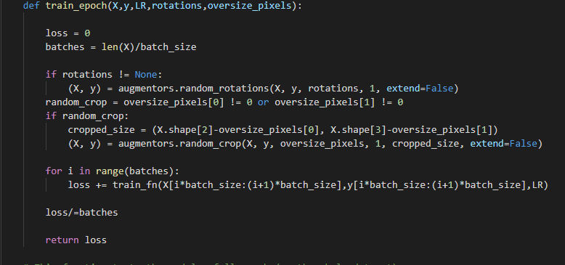
Train and get parameters

Slide 18
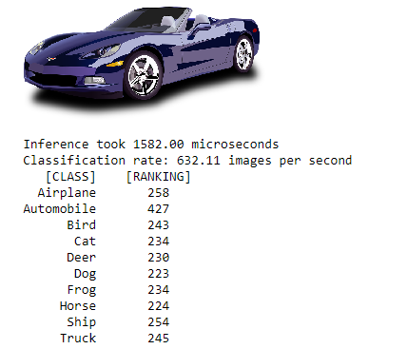
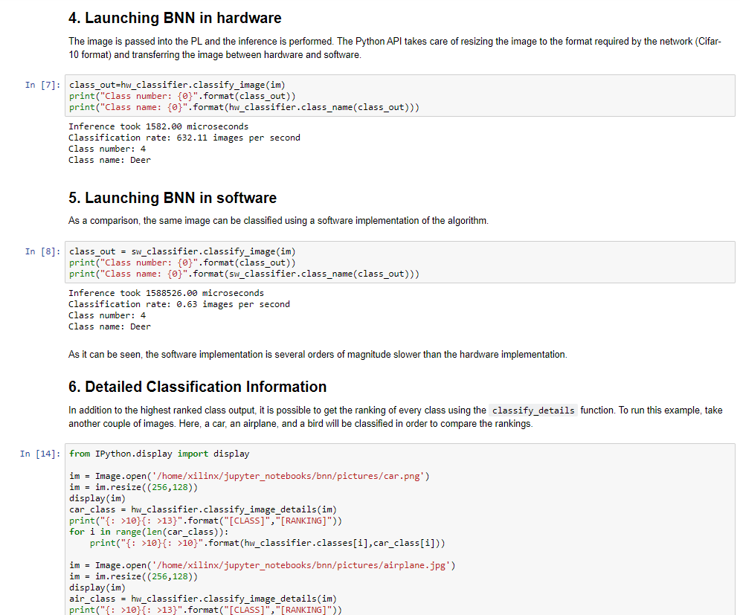
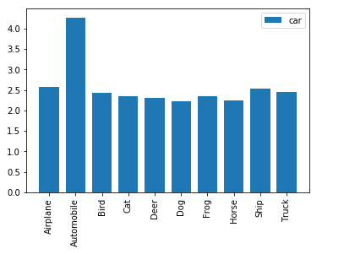
Pynq implementation

Slide 19
Outline
Basic introduction to BNN and FINN
Optimization and resource utilization trade-off
Overall system flow
Implementation on FPGA (Pynq-Z2 board)
Experiment

Slide 20
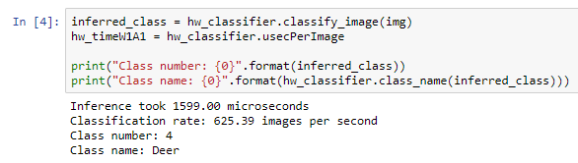
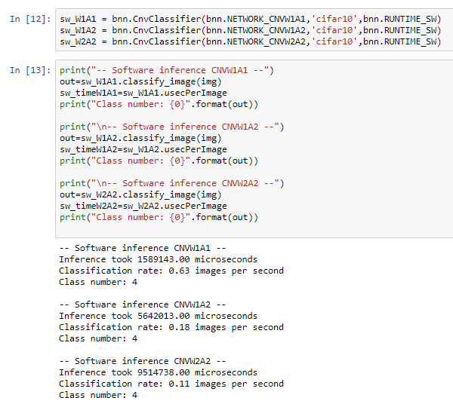
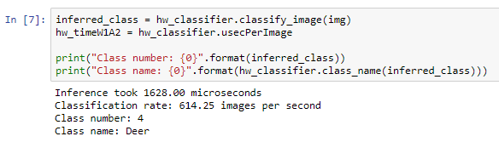

Hardware - 1 bit weight and 1 bit activation
Hardware speed-up
Software
Hardware - 1 bit weight and 2 bit activation
Hardware - 2 bit weight and 2 bit activation

Slide 21
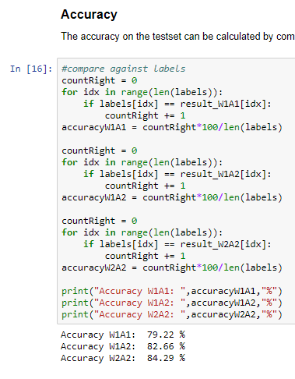
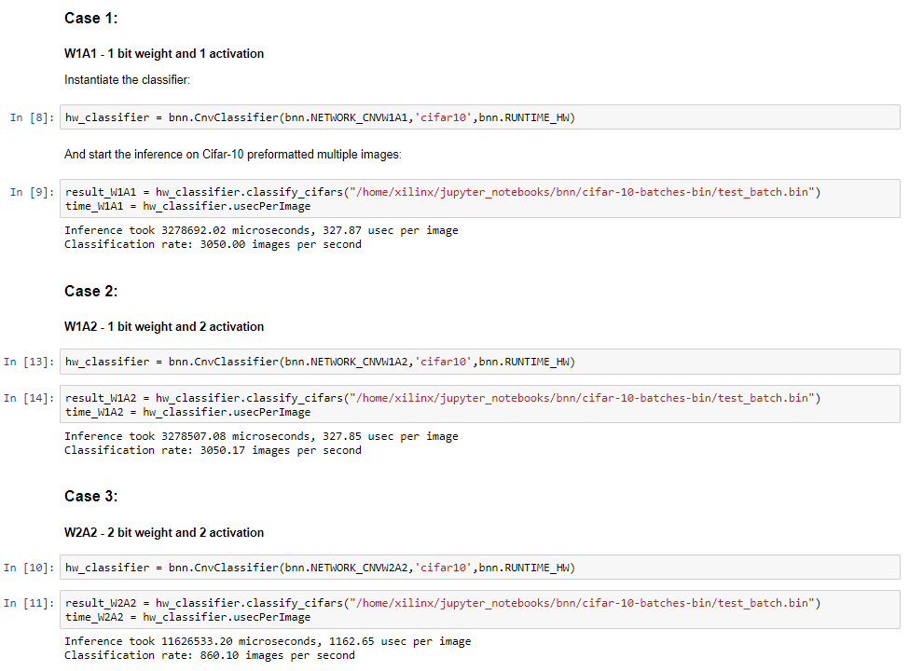
Precision and Accuracy
1 bit weight and 1 bit activation
1 bit weight and 2 bit activation
2 bit weight and 2 bit activation

Slide 22
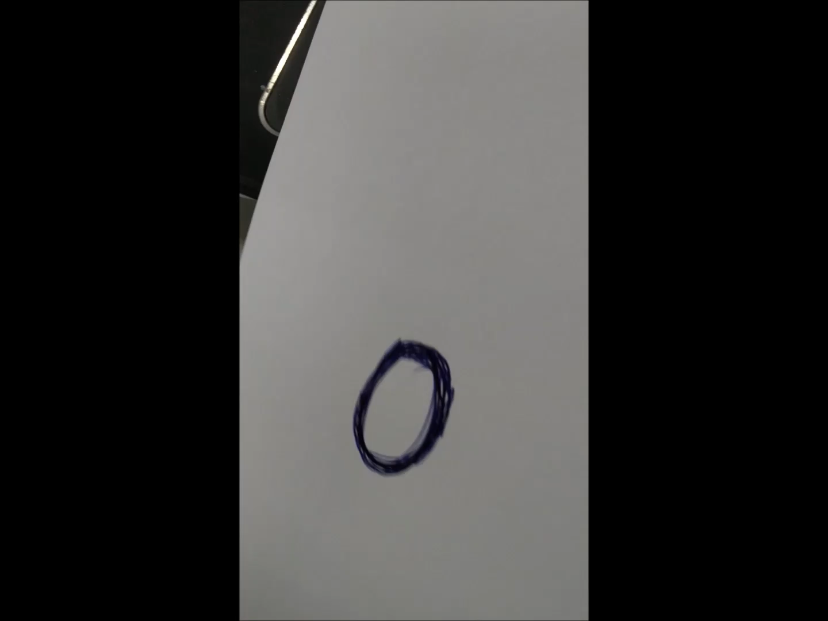
Demo
Apply an additional camera on pynq, read the input image and classify the image on our board.

Slide 23
Reference
FINN: A Framework for Fast, Scalable Binarized Neural Network Inference
https://arxiv.org/abs/1612.07119
rosetta BNN https://github.com/cornell-zhang/rosetta
BNN-pynq https://github.com/Xilinx/BNN-PYNQ
M. Courbariaux and Y. Bengio. Binarynet:
Training deep neural networks with weights and activations constrained to +1 or -1. CoRR, abs/1602.02830, 2016
CNN using HLS https://github.com/amiq-consulting/CNN-using-HLS

